Slide 1
MCV-M2:
Image Inpainting and Completion
Exercise: Low Level Segmentation
Team 7 - Joan F. Serracant, Martí Cobos.

Slide 2
Index
Image Low Level Segmentation
Computer vision pipeline for Low Level Segmentation
Test images
Conclusions

Slide 3
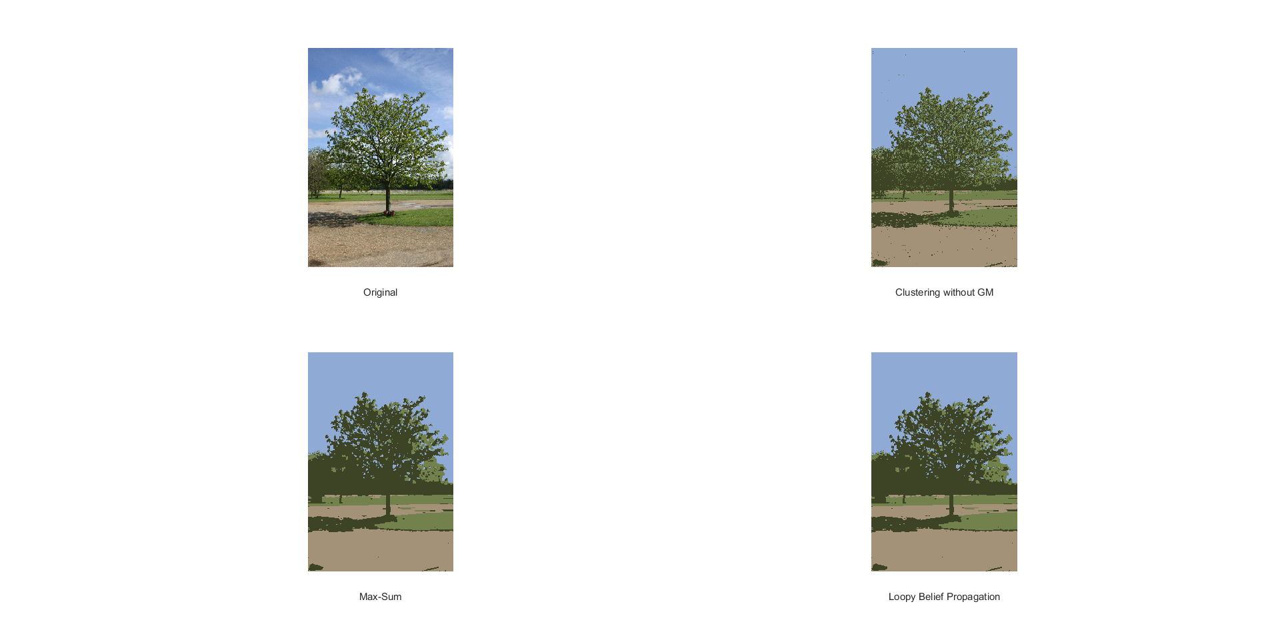
Image Low Level Segmentation
Exercise: image low level segmentation based on color GMMs and graphical models
Original image
Segmentation result

Slide 4
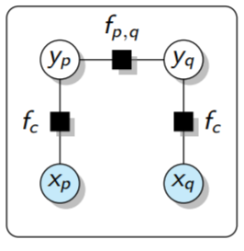
Computer vision pipeline for Low Level Segmentation
Computer vision pipeline for Low Level Segmentation based on GMM clustering and graphical models:
Input image
Convert to Lab
(optional)
Fit GMM with K clusters
Build graphical model
Segment using graph cut inference algorithm
GMM as unary potentials and Potts model for pairwise potential

Slide 5
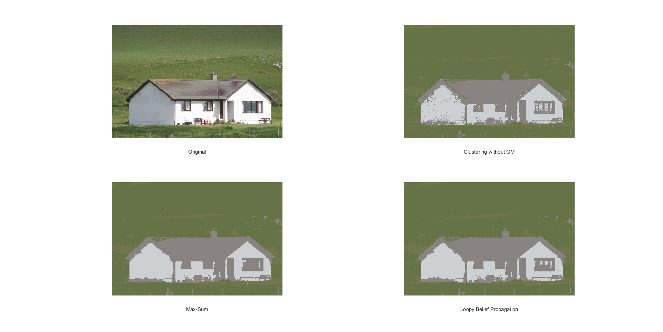
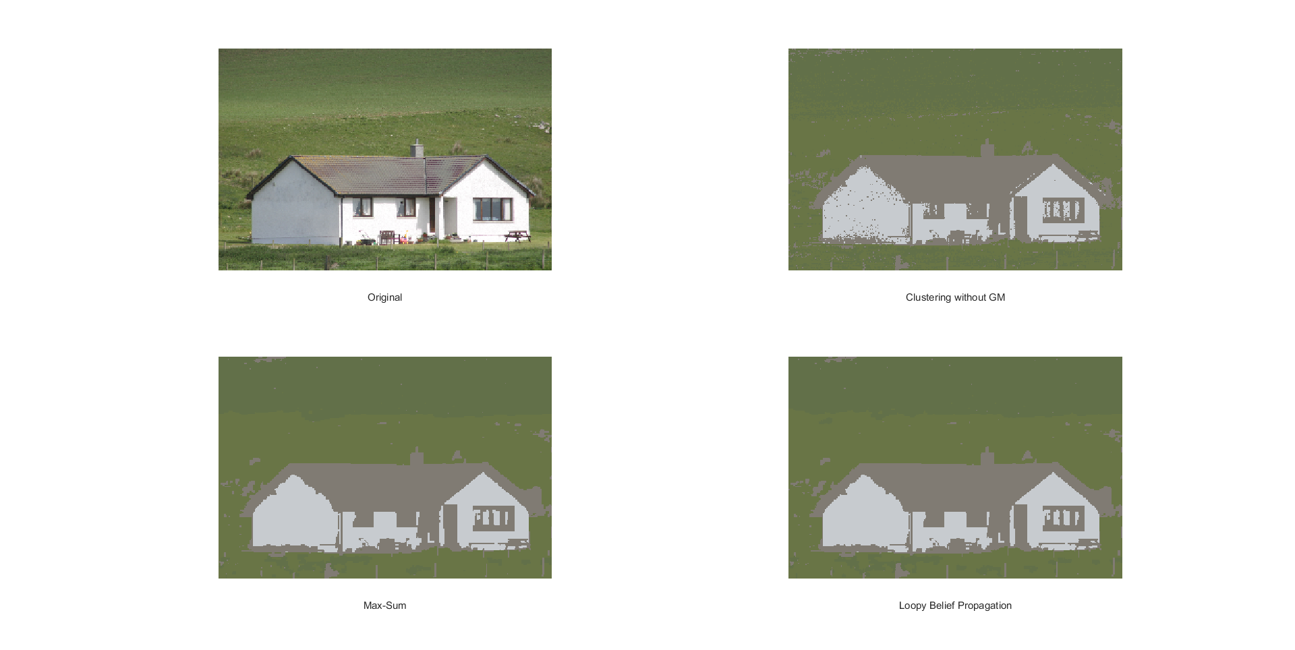
Test images
Segmentation with RGB image:
Segmentation with images converted to LAB:
Segmentation in Lab space provides slightly better results. From this point Segmentation on Lab space will be used

Slide 6
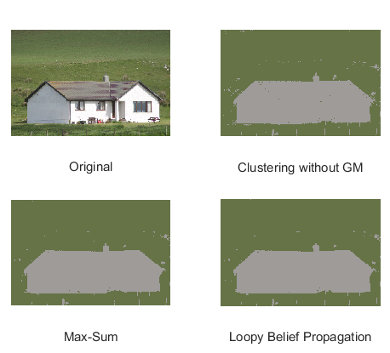
Test images
4 GMM Clusters result :
2 GMM Clusters result :
By segmenting the image with 2 clusters, the house can be segmented form the background

Slide 7
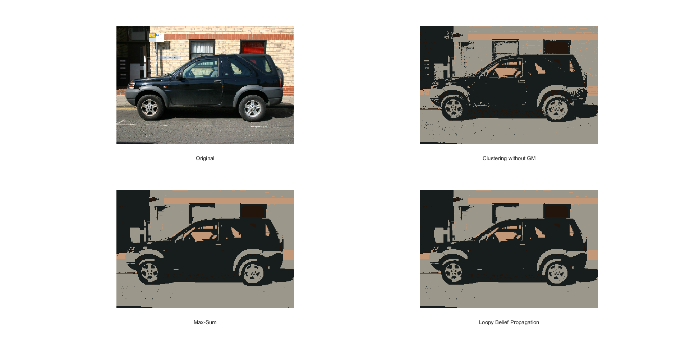
Test images
Additional images:

Slide 8
Conclusions
By using graphical model, image segmentation takes into account information form the neighbouring pixels, in contrast to GMM color segmentation which only uses pixel RGB values.
Converting image from RGB to Lab yields to slightly better results. The main reason is that Lab color space separates chromaticity and luminosity.
Number of clusters (segmentation levels) can be adapted depending on the segmentation task.
There is no significant difference between “Max-Sum” and “Loopy Belief Propagation” inference algorithms.

